Slide 1
INTERNET OF THINGS CYBER ATTACKS DETECTION USING MACHINE LEARNING
PRESENTED BY:
ARUL.P (811419104004)
ABIRAMI.I (811419104002)
SIVA SANKARI.P (811419104013)

Slide 2
TABLE OF CONTENT
1. OBJECTIVE.
2. ABSTRACT.
3. INTRODUCTION.
4. PROPOSED SYSTEM.
5. CYBER ATTACKS IN NETWORK.
6. MACHINE LEARNING ALGORITHM.
7. RANDOM FOREST ALGORITHM.
8. MODULE LIST.
9. RECUREMENTS.
10.ADVANTAGE & DISADVANTAGE.
11.CONCLUSION.

Slide 3
OBJECTIVE
Ensuring the accessibility of an IoT system and its services. The IoT System can validate the occurrence of any events and the data completeness and accuracy is preserved. Machine Learning algorithms using to identify and alert to suspicious activity in IoT System.

Slide 4
ABSTRACT
The IoT combines hundreds of millions of devices which are capable of Interaction with each other.
IoT is vulnerable to numerous types of cyber attacks.
Regard less that attacks cannot be wholly avoided forever, early detection of an attacks crucial for practical defense.
Although many studies in recent years have discussed the use of Machine Learning (ML) solutions in attacks detection problems.
In our proposed method we are implementing the ANN based Machine Learning algorithms for predicting the cyber attacks over IoT Networks.

Slide 5
INTRODUCTION
The IoT every object is uniquely identified and accessible to the Networks.
IoT revolves around the Interconnection completeness amongst things, devices, and people.
The main goal of Artificial Intelligence is to develop self-reliant machines that can think and act like humans.
Deep learning’s core concept lies in artificial neural networks, which enable machines to make decisions.
Extract new features from the dataset and select the most appropriate features to improve machine learning algorithm performance.

Slide 6
PROPOSED SYSTEM
Improvement in attack detection in IoT networks by evaluating the performance of machine learning algorithms on a recent IoT dataset.
The data pre-processing process was performed in the first step before dividing the dataset into two parts: training and test.
The properties to be used by the algorithms are decided in the feature selection step.
Finally, our approach ends with the implementation of machine learning algorithms (ANN) .

Slide 7
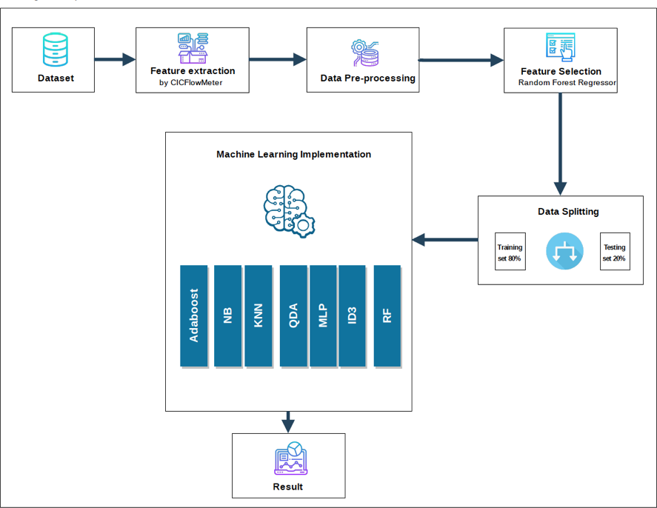
Proposed Approach Overview

Slide 8
Deep Learning
Deep Learning is a machine learning technique that teaches computers to do what comes naturally to humans.
Deep Learning Techniques :
Convolutional Neural Networks (CNN).
Long Short Memory Networks (LSTMs)
Recurrent Neural Networks (RNNs).
Artificial Neural Network:
An artificial neural network is usually a computational network based on biological neural networks that construct the structure of the human brain. Its interconnected group of nodes.

Slide 10
Cyber Attacks in Network

Slide 11
DoS/DDoS Attacks
DoS Attack :
A Denial–of–Service (DoS) attack floods a server with traffic, making a website or resource unavailable.
DDoS Attack :
A Distributed Denial-of-Service (DDoS) attack is a DoS attack that uses multiple computers or machines to flood a targeted resource.

Slide 13
MACHINE LEARNING ALGORITHM:
The Stochastic Gradient Descent (SGD).
Artificial Neural Network.
Feed Forward Neural Network.
Classification algorithm.
Random forest algorithm.
Non-Dominated Sorting Genetic Algorithm (NSGA –II).
Genetic Algorithm (GA).
Random forest Algorithm
Random forest algorithm is a commonly- used machine learning algorithm.
Combines the output of multiple decision tree to reach a single result.

Slide 14
Random forest Algorithms

Slide 15
Feature Selection
the method of reducing the dimensionality of datasets by applying some appropriate algorithm. The feature selection is a crucial step as it directly affects the performance of the machine learning classifier.

Slide 16
Non-Dominated Sorting Genetic Algorithm:
NSGA-II incorporates standard GA (select, crossover, and mutation) with non-dominated sorting and new fitness value “Crowding Distance” which is assigned in order to measure the density of solutions surrounding a particular solution.

Slide 18
Modules List
1. DATASET.
2. DATA EXTRACTION.
3. DATA PRE-PROCESSING.
4. FETURE SELECTION.
5. DATA SPLITTING.
6. IMPLEMENTION.

Slide 19
DATASET
Dataset is a collection of various types of data stored in a digital format.
Datasets primarily consist of image, texts, audio, videos, numerical data points, etc.
our project was used in numerical data point or (.csv) file.
DATA EXTRACTION
Data extraction is the process of collecting or retrieving disparate types of data from a variety of sources.

Slide 20
DATA PRE-PROCESSING.
Data pre-processing transforms the data into a format that is more easily and effectively processed in data mining, machine learning and other data science task.
FEATURE SELECTION
Feature selection is the method of reducing the input variable to your model by using only revelent data getting rid of noise in data.

Slide 21
DATA SPLITTING
Data splitting is commonly used in machine learning to split data into train, test, or validation set.
Our project was used in
Training = 80%
Testing = 20%

Slide 22
IMPLEMENTION OF RANDOM FOREST
Select random samples form the given data or training set.
This algorithm will construct a decision tree for every training data.
Voting will take place by averaging the decision tree.
Finally, select the most voted prediction result as final prediction result.

Slide 23
Hardware specification
Processors: Intel® Core™ i5 processor 4300M at 2.60 GHz or 2.59 GHz (1 socket, 2 cores, 2 threads per core), 8 GB of DRAM.
Disk space: 320 GB.
Operating systems: Windows® 10, macOS*, and Linux*.
Software Specification
Python : 3.9 version

Slide 24
APPLICATIONS
Firewalls.
Anti-virus software.
Intrusion detection and prevention system(IDPS).
Data loss prevention(DLP).
Network security monitoring.
Endpoint detection and responce(ERD).

Slide 25
ADVANTAGES
Recovery of the system.
Data Safety from hackers.
Protect business reputation.
Handles data management.
System availability and improve data.
Saves the bottom line.

Slide 26
DISADVANTAGES
Slow down the system.
Can do risky.
Only some updation are suitable for system.
Security patches may backfire.
Need Constant monitoring.

Slide 27
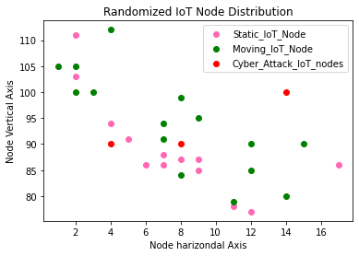
RESULT

Slide 28
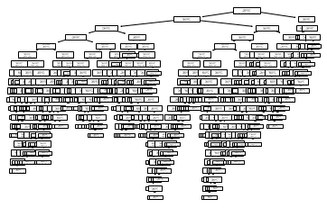

Slide 29
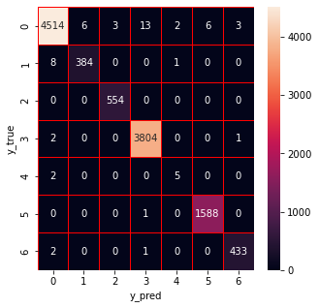

Slide 30
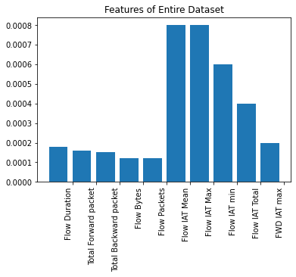

Slide 31
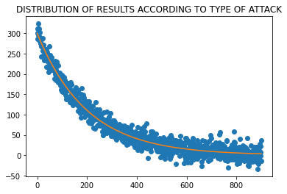

Slide 32


Slide 33
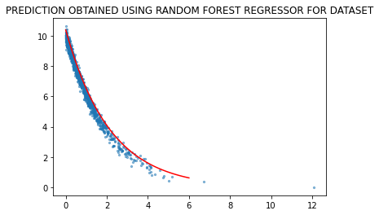

Slide 34
CONCLUSION
This paper has aimed to detect IoT network attacks by using machine learning methods.
We used CIC Flow Meter[25] to extract flow-based features from the raw traffic traces.
During the implementation, the importance of weight calculations were made with the Random Forest algorithm.
Finally, seven machine learning algorithms which are widely used and have different qualities were applied to the data.
These algorithms and the achieved performance ratios according to F-measure .

Slide 35
REFERENCES
[1].J. Singh, T. Pasquier, J. Bacon, H. Ko, and D. Eyers, ‘Twenty security considerations for cloud-supported Internet of Things’, IEEE Internet of things Journal, vol. 3, no. 3, pp. 269–284, 2015.
[2] I. H. S. Statista, ‘Internet of Things (IoT) connected devices installed base worldwide from 2015 to 2025 (in billions)’, 2018.
[3] C. Kolias, G. Kambourakis, A. Stavrou, and J. Voas, ‘DDoS in the IoT: Mirai and other botnets’, Computer, vol. 50, no. 7, pp. 80–84, 2017.
[4] A. Lohachab and B. Karambir, ‘Critical Analysis of DDoS—An Emerging Security Threat over IoT Networks’, J. Commun. Inf. Netw., vol. 3, no. 3, pp. 57–78, Sep. 2018, doi: 10.1007/s41650-018-0022-5.
[5] S. Sicari, A. Rizzardi, D. Miorandi, and A. Coen-Porisini, ‘REATO: REActing TO Denial of Service attacks in the Internet of Things’, Computer Networks, vol. 137, pp. 37–48, 2018.
[6] L. Deng, ‘A tutorial survey of architectures, algorithms, and applications for deep learning’, APSIPA Transactions on Signal and Information Processing, vol. 3, 2014.

Slide 36
THANK YOU

